Slide 1

Welcome
Auckland, New Zealand
18-20 February 2019

Slide 2
Database Internals meets Power BI
Patrick Flynn

Slide 3




Thanks to our sponsors
Platinum Sponsors
Silver
Exhibitor

Slide 4




Patrick Flynn SQL Server DBA Link Group
MCM – SQL Server 2008
MCSM – Data Platform
Production DBA for 10+ years.
https://github.com/sqllensman/Presentations
sqlsaturday@sqllensman.com
@sqllensman
Patrick Flynn

Slide 5
Agenda:
Review of Database Internals
“Basic Commands”
Demo

Slide 6
TOOLS OF TRADE

Slide 7
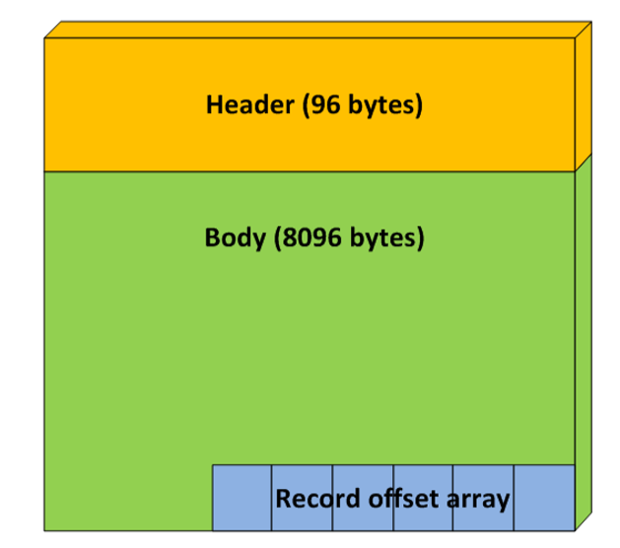
Structure of Page

Slide 8
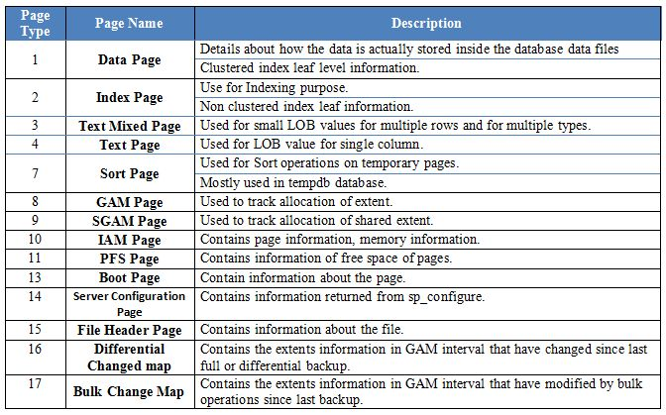

Slide 9
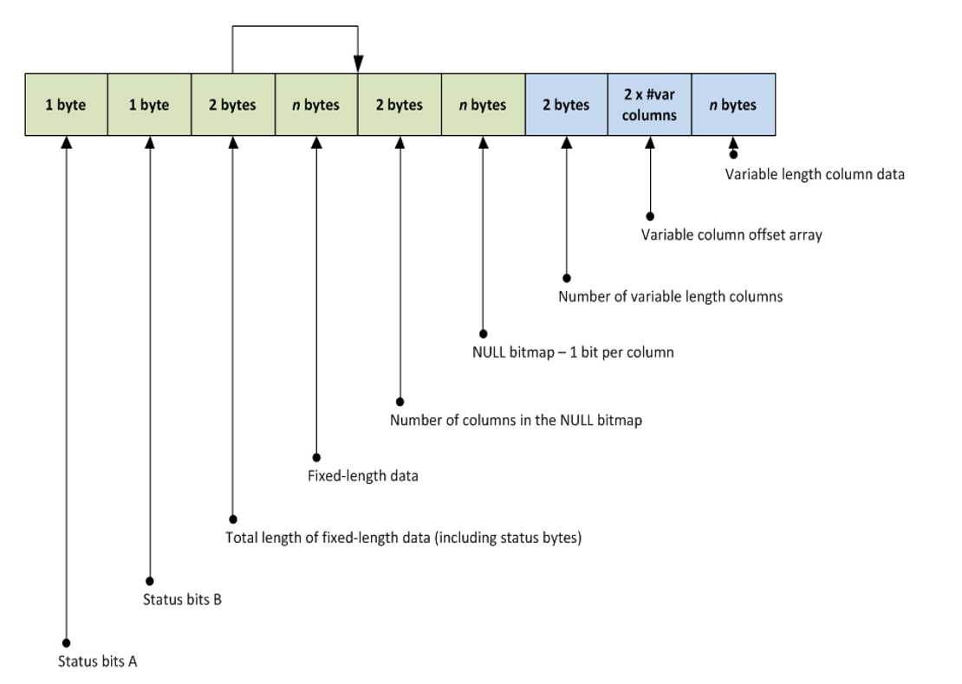
Page Structure at Byte Level
Data Record
Notes:
http://improve.dk/deciphering-a-sql-server-data-page/
http://aboutsqlserver.com/2013/10/15/sql-server-storage-engine-data-pages-and-data-rows/

Slide 10
Tools of Choice
sys.fn_PhysLocCracker
DBCC IND
DBCC PAGE
sys.fn_PhysLocFormatter
sys.system_internals_allocation_units
sys.system_internals_partition_columns
sys.dm_db_database_page_allocations
Notes:
Trace Flags: 3604

Slide 11
Demo

Slide 12
Resources
SQL Skills – Paul S Randal
http://www.sqlskills.com/blogs/paul/category/inside-the-storage-engine/
ORCA MDF – Mark S Rasmussen
http://improve.dk/category/SQL%20Server%20-%20OrcaMDF/
https://synoptic.design/

Slide 13


Evaluate Sessions and Win a Prize!
https://www.surveymonkey.com/r/5LR9LFB

Slide 14
Thanks to our sponsors
Platinum Sponsors
Silver
Exhibitor

